Slide 1
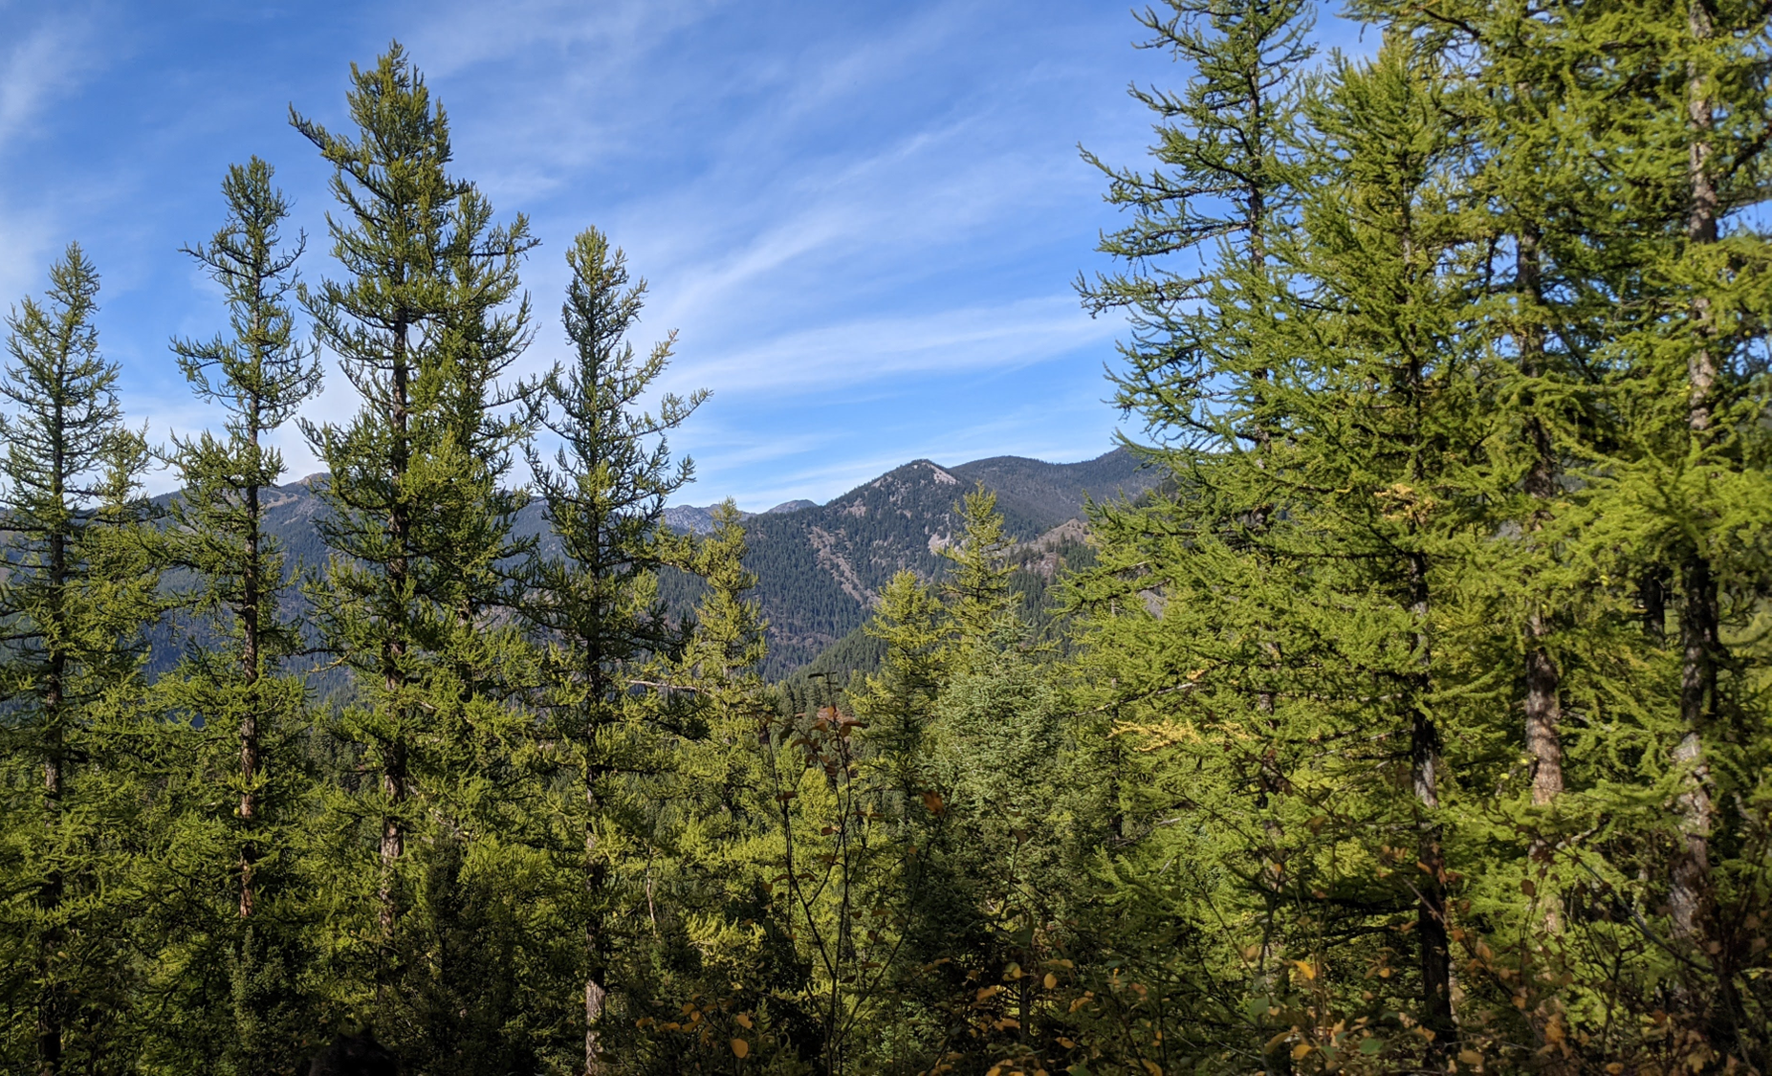
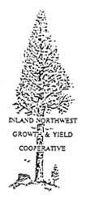

Evaluating the effects of forest community composition on western larch growth
Christian Mercado
Committee: David Affleck, Andrew Larson, Justin Crotteau, David Patterson
University of Montana, Missoula, MT, USA
Notes:
<intro>
Western larch (Larix occidentalis) is a deciduous conifer that grows exclusively within the inland northwestern region of North America.
It is akin to Larix laricina, or eastern larch, however unlike its eastern counterpart, western larch holds considerable timber value.
It generally grows tall and straight and can grow to large diameters with heights well over 100 feet. its lumber is mixed with that of douglas-fir, which speaks to its value.
Western larch grows at various elevations, spanning across subalpine environments.
It is also very intolerant of shade, has thick bark, and establishes prolifically after fire in mineral soil, making it both fire resistant and resilient.

Slide 2
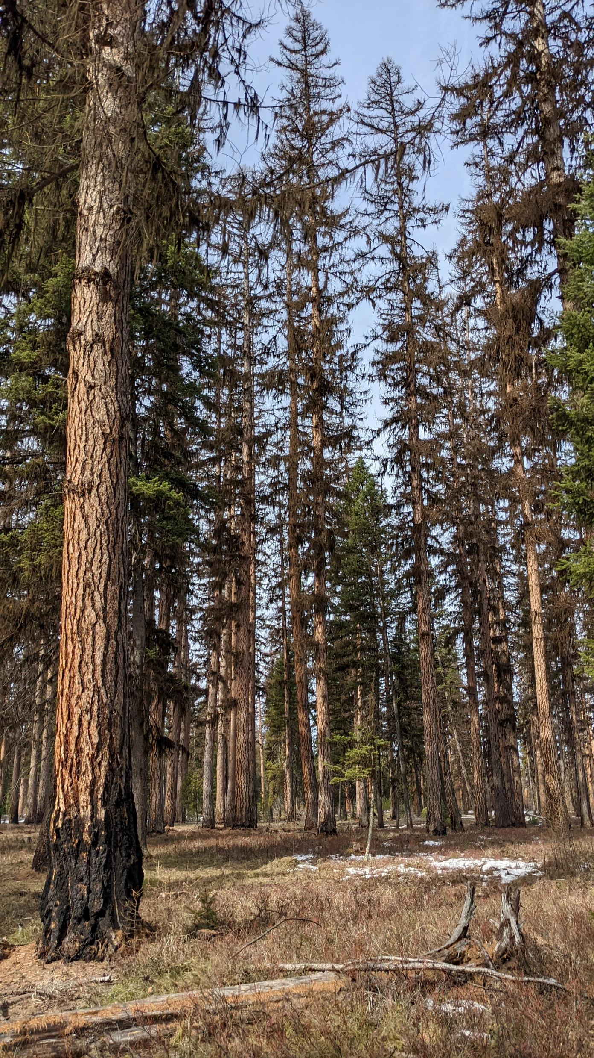
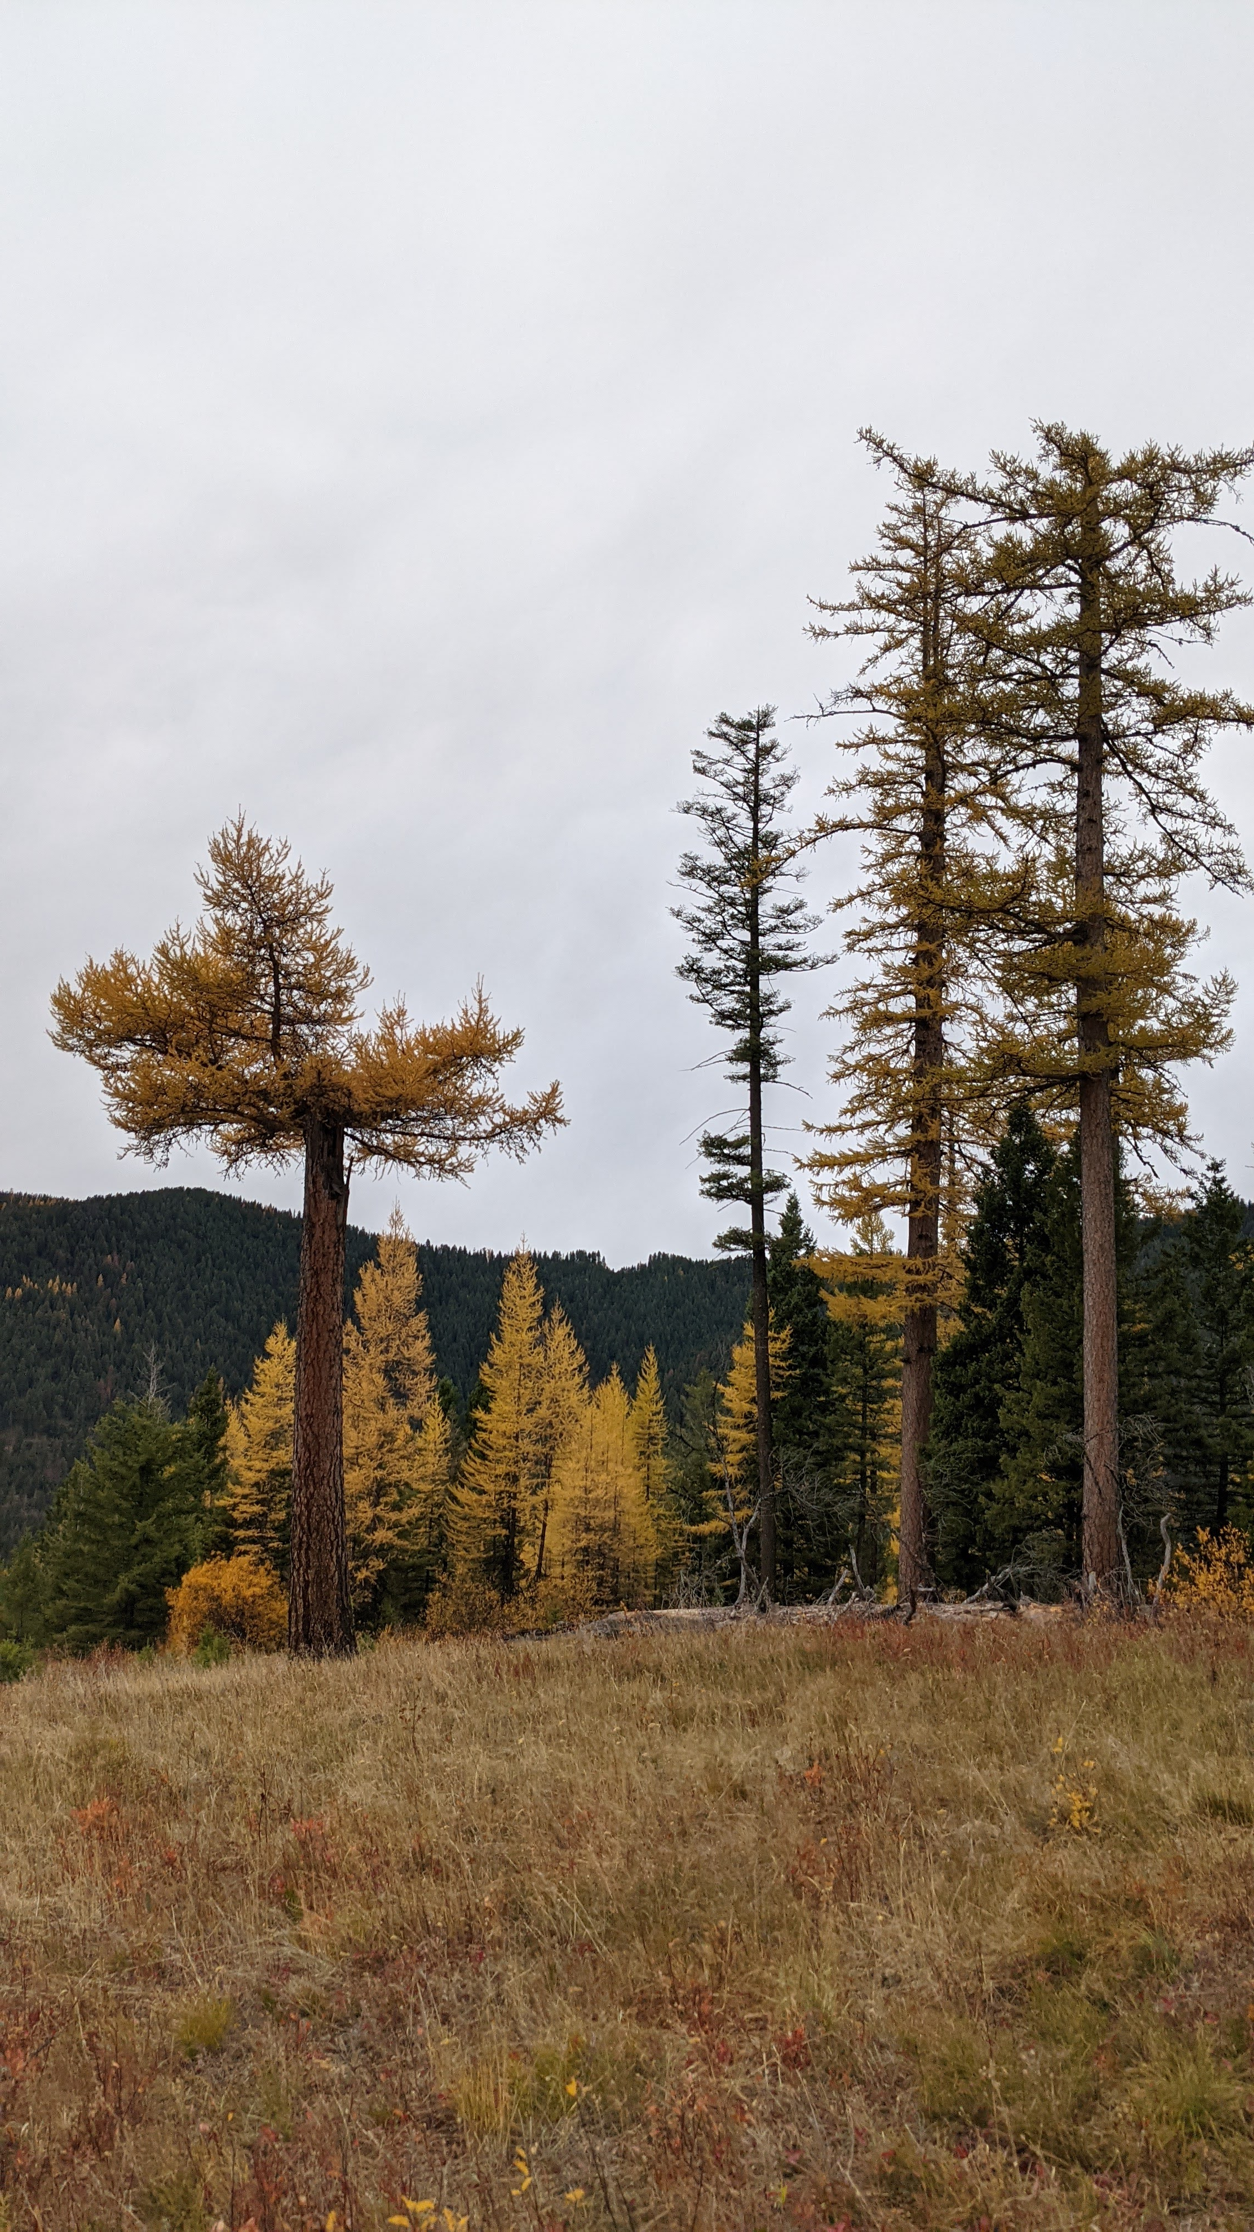
Larix occidentalis – Western larch
Notes:
Western larch (Larix occidentalis) is a deciduous conifer that grows exclusively within the inland northwestern region of North America. It is akin to Larix laricina, or eastern larch, however unlike its eastern counterpart, western larch holds considerable timber value. It generally grows tall and straight and can grow to large diameters with heights well over 100 feet. its lumber is mixed with that of douglas-fir.
Western larch grows at various elevations, spanning across subalpine environments.
It is also very intolerant of shade, has thick bark, and establishes prolifically after fire in mineral soil, making it both fire resistant and resilient.

Slide 3
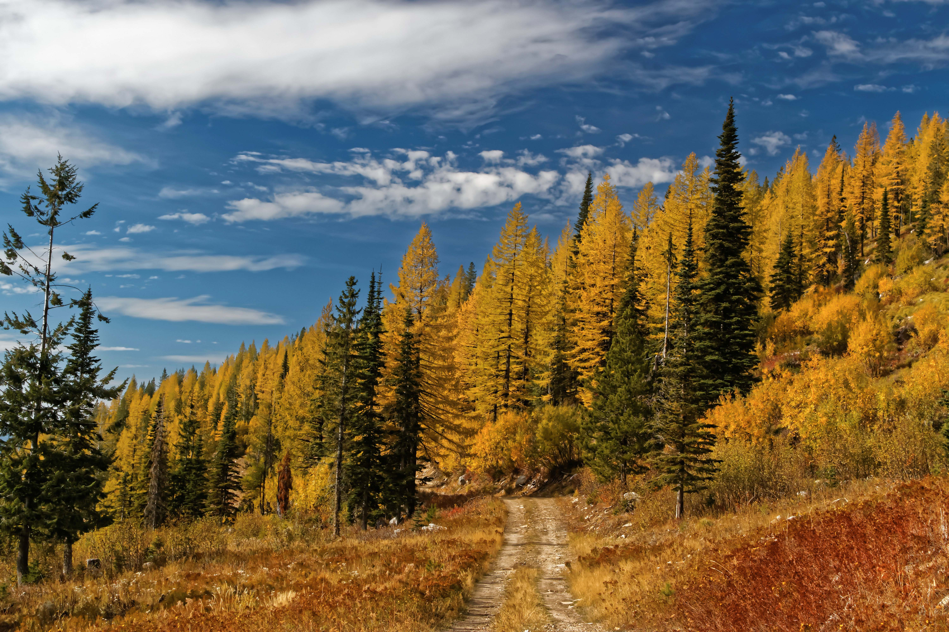
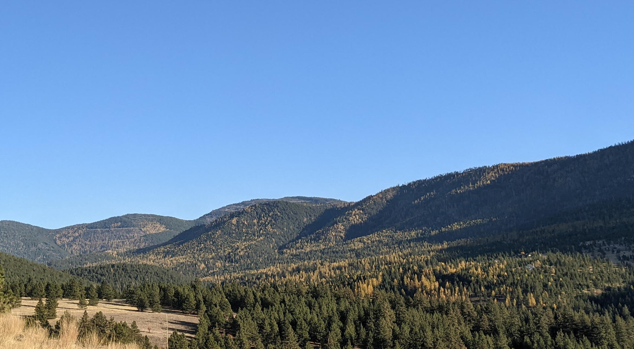
Larix occidentalis – Western larch
Shade intolerant
W. Larch
Lodgepole pine
Ponderosa pine
White pine
Douglas-fir
Grand fir
Subalpine fir
Engelmann spruce
W. Redcedar
Shade tolerant
W. Hemlock
Pacific yew
Notes:
Sometimes managed in plantations with only larch, but since management in this region is not very intensive, it oftentimes is managed with other species.
Those species are shown on the left by order of shade tolerance, where on top are shade intolerant trees like larches and pines, and on the bottom there are trees that thrive in the shade, like fir, spruce, and hemlock.
In the photo on the right, larch are the yellow trees, others are green.
In mixed-species forests like this one, different species fill different ecological niches. That is, each species has its own methods in which it acquires resources that it needs to grow.
Naturally, trees compete for water, light, and nutrients in a stand like this, especially when two species fill the same niche.
However, recent research has suggested that the ecological niches which two species occupy in a stand might actually be complementary of one another, meaning that the way that two species acquire or use resources can lead to less competition for those resources compared to when trees of the same species or that fill the same niche grow with one another.
In other words, niche complementarity among species can lead to competitive reduction in mixed-species stands.
Since competition may be reduced when there is niche complentarity among species in a stand, one might expect that growth of trees in that stand could be higher than trees of the same species in a different stand where niche complementarity is not present.
In fact, various studies have shown that growth and yield can be effected by species-mixing, but very few studies of this nature have been conducted in western north America.
Additionally, quantifying species niche can be somewhat difficult, so examining niche complementarity effects on growth requires investigation.
Since shade tolerance relates to how a tree acquires or uses light, it may be used to describe its light-seeking niche as well.
So, in theory when shade-intolerant western larch grows with more shade tolerant firs and spruces, one might expect to see less competition for light compared to when larch is growing with larch or other shade-intolerant species.
but until now, no such research has evaluated the impacts of species composition on the growth of western larch.
Many of the species that western larch grows with are shown on the left in order of shade tolerance, where the top species are very intolerant of shade, and the bottom are shade tolerant.
Various models, such as those in FVS, have characterized how western larch grows, however, these models don’t explicitly account for species-mixing impacts.
In each of these photos, larch is revealed by a golden-yellow color. It naturally occurs across a range of forest species community compositions: sometimes as a minor component of a forest like in the left photo, all the way to pure stands, like in the photo on the right.

Slide 4
Question:
How does community composition impact the growth of western larch?
Expectation:
Higher growth when growing with shade-tolerant species
Notes:
Provided with this information, my primary research question was:
How does community composition impact the growth of western larch?
Given the hypothesis that that shade tolerance accounts for species light-use niche and that niche complementarity modifies growth through competitive reduction, my expectation was that western larch would experience higher rates of growth when mixed with species that are more shade-tolerant than it.

Slide 5
Questions
After accounting for other factors, how does community composition impact the growth of western larch?
How can species-mixing effects be captured within an individual tree growth model?
Notes:
Provided with this information, my primary questions were:
How does community composition impact the growth of western larch once all other influencing factors are accounted for?
And
How can the effects of species-mixing on growth best be captured within an empirical individual-tree growth model?

Slide 6
Objectives
Describe how W. Larch growth varies with tree size, competition, density, and site productivity.
Identify if these growth effects differ between mixtures and pure larch conditions
Compare different measures of species-mixing influences on growth
Notes:
The associated objectives were then to
First, describe how western larch growth varies with tree size, competition, stand density, and site productivity. These things are known to explain variation in tree growth already, but they do not address interspecific dynamics.
Once these effects were captured, and in order to address community composition effects on growth, my second objective then was to see if these growth effects varied when western larch was growing with other species, compared to when it was growing with other larch.
Identify differences in the growth relationship of western larch in mixed-species communities compared to those of western larch growing in ‘pure larch’ conditions.
Now it’s one thing if growth effects vary across mixtures, but if it does, there ought to be a way to capture that effect after accounting for these other effects.
So, my third objective was to compare different variables that represent species-mixing after accounting for size, competition, and site effects on growth.
That way I could specifically address if shade-tolerance (for example) has an important effect on growth after accounting for these other effects.

Slide 7
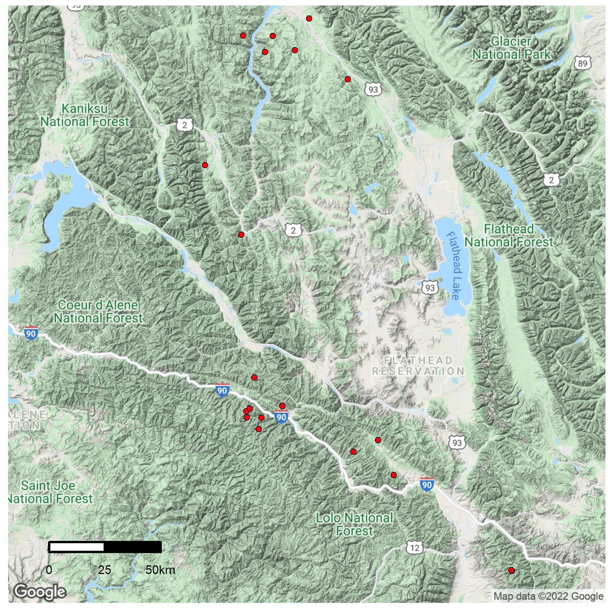
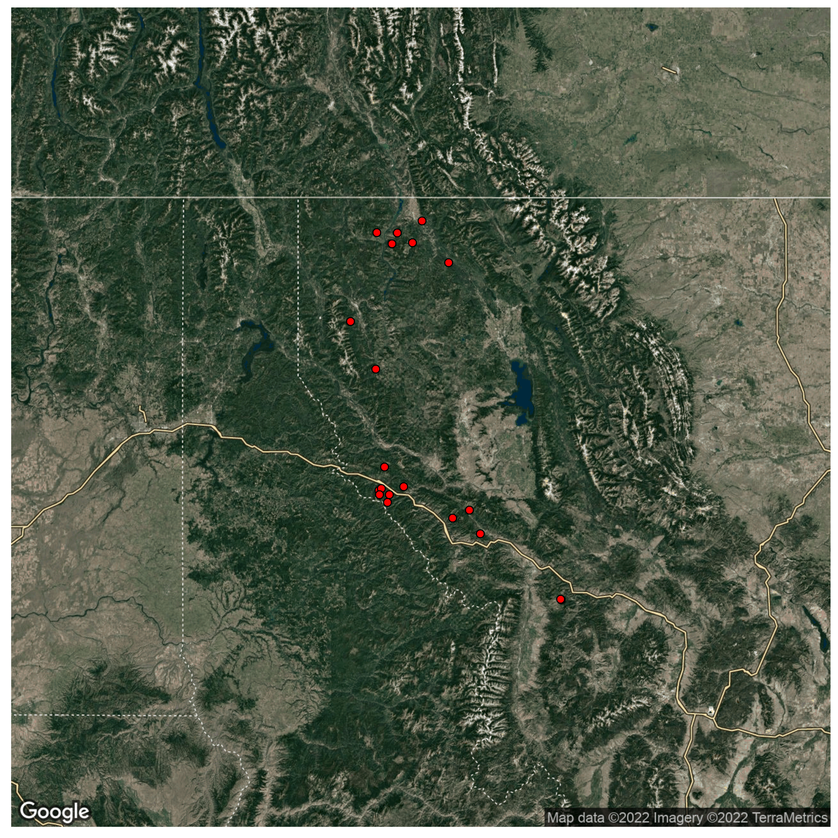
Tree growth data
Permanent Growth Plots
18 stands on 2 National Forests in Montana
Various attributes collected (DBH, HT., etc.)
Canada
USA
Montana
Washington
Idaho
Missoula
Notes:
To describe how western larch growth varies, I used a data set that consists of repeat-measurements on trees in various stands on national forest lands that were initially measured in the 1980’s. The locations of theses stands were throughout the northwestern corner of Montana, as shown by red dots on the map.
Each of these stands were measured 4 or 5 times between 1980 and 2021 and the time between measurements was highly irregular throughout this period.
These stands are a subset of a much larger data set that spans the inland northwest.
Data collection occurred on these stands in 2021 specifically because they had a high proportion of western larch at the most recent measurement.

Slide 8
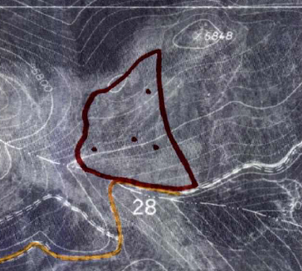
Tree growth data
Permanent Growth Plots
18 stands on 2 National Forests in Montana
Various attributes collected (DBH, HT., etc.)
Canada
USA
Montana
Washington
Idaho
Missoula
Notes:
These stands consist of 4 plot clusters that were randomly located within a stand, as shown by black dots on the hand-drawn stand map.
Each stand was treated with thinning, where three plot clusters were thinned, and the fourth was left as an un-thinned control plot, providing a side-by-side comparison of growth between thinned-and-unthinned conditions at the same site.

Slide 9
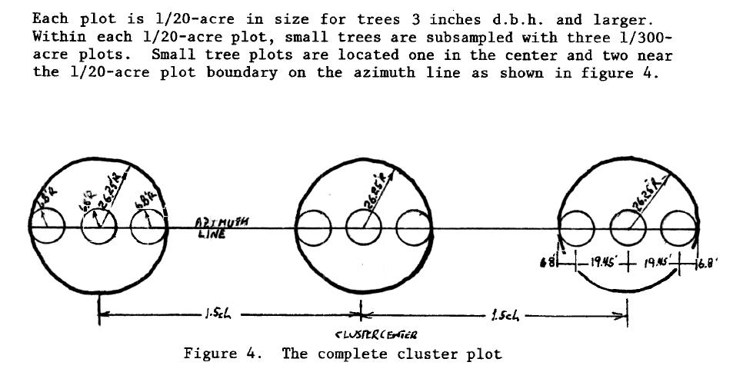
Tree growth data
Permanent Growth Plots
18 stands on 2 National Forests in Montana
Various attributes collected (DBH, HT., etc.)
Canada
USA
Montana
Washington
Idaho
Missoula
Notes:
Each cluster contains 3 sample plots where data was collected on large-trees, and each of those plots contains 3 sub-plots, where data was collected on small trees.
The figure on the top right shows what a plot cluster looks like, where the large circles are large tree plots, and the small-tree plots are nested within those larger plots, shown by the smaller circles.
Large and small plots were a fixed area, representing 1/20th of an acre and 1/300th of an acre, respectively.
Within the large-tree plots, data such as: DBH, height, crown ratio, as well as biotic and abiotic damage data were collected on trees larger than an established diameter threshold.
Since it takes a while to measure tree heights, height was only measured a subset of large trees within each plot.
Large trees were tagged at the time of initial measurement so that they’re data could be linked over time between measurements.
At subsequent measurements, trees that grew above the diameter threshold since the previous measurement were tagged and added to the data set as large-trees for remeasurement.
Within the small-tree sub-plots, trees were tallied by species and height, and DBH was measured on trees taller than 4.5 feet, but that had diameters smaller than the threshold.
In both small and large tree plots, trees were counted as live or dead, providing information on tree mortality over time as well.
Additionally, GPS points were taken at each cluster of plots. These GPS points were plugged into google earth engine, and terrain characteristics were extracted, such as slope, aspect, elevation, and heatload.
Since I was interested in tree growth, I only used data on trees that were alive.
Tree growth was calculated with basal area increment, which I will define in a moment.
Data was collected on trees of every species, but in these analyses, growth was only assessed on western larch since that was the species of interest.
From here, I’ll describe my analysis
All models were informed by a long-term data set which consists of repeat measurements on trees within 18 forest stands in northwestern Montana.
The map here shows the rough locations of study areas used, where each dot represents a stand. Site conditions like slope, aspect, and elevation were variable across stands in the data set.
These data are part of a larger network of permanent growth plots (or PGP’s) that were installed in the 1980’s to monitor tree growth in response to thinning.
Given this, each stand contained 4 plot clusters, 3 were treated with thinning (precommercial thinning) and 1 was left un-thinned as a control.
Trees within plots were tagged and measured about 40 years ago, and subsequent remeasurements on the same trees (and new trees) were taken at varying increments of time since then.
In 2021 I led a crew of 3 to conduct re-measurements on these 18 stands. We chose to re-measure these stands because they had a high presence of western larch data in them.
The photo on the right shows the center of a control plot that is nearly pure western larch.
Various attributes were collected on trees, including DBH, height, crown class, crown ratio, tree biotic and abiotic damage, and other info.
Each stand was measured 4 or 5 times over the last 40 years.

Slide 10
Tree growth data
Permanent Growth Plots
18 stands on 2 National Forests in Montana
Various attributes collected (DBH, HT., etc.)
Canada
USA
Montana
Washington
Idaho
Missoula
Notes:
To describe how western larch growth varies, I used a data set that consists of repeat-measurements on trees in various stands on national forest lands that were initially measured in the 1980’s. The locations of theses stands were throughout the northwestern corner of Montana, as shown by red dots on the map.
Each of these stands were measured 4 or 5 times between 1980 and 2021 and the time between measurements was highly irregular throughout this period.
These stands are a subset of a much larger data set that spans the inland northwest.
Data collection occurred on these stands in 2021 specifically because they had a high proportion of western larch at the most recent measurement.
These stands consist of 4 plot clusters that were randomly located within a stand, as shown by black dots on the hand-drawn stand map. Each stand was treated with thinning, where three plot clusters were thinned, and the fourth was left as an un-thinned control plot, providing a side-by-side comparison of growth between thinned-and-unthinned conditions at the same site.
Each cluster contains 3 sample plots where data was collected on large-trees, and each of those plots contains 3 sub-plots, where data was collected on small trees.
Within the large-tree plots, DBH, height, crown ratio, as well as biotic and abiotic damage data were collected on trees larger than an established diameter threshold. Since it takes a while to measure tree heights,
height was only measured a subset of large trees within each plot.
Large trees were tagged at the time of initial measurement so that they could be tracked over time.
At subsequent measurements, trees that grew above the diameter threshold since the previous measurement were tagged and added to the data set as large-trees for remeasurement.
Within the small-tree sub-plots, trees were tallied by species and height, and DBH was measured on trees taller than 4.5 feet, but that had diameters smaller than the threshold.
In both small and large tree plots, trees were counted as live or dead, providing information on tree mortality over time as well.
Additionally, GPS points were taken at each cluster of plots. These GPS points were plugged into google earth engine, and terrain characteristics were extracted, such as slope, aspect, elevation, and heatload.
Since I was interested in tree growth, I only used data on trees that were alive.
Tree growth was calculated with basal area increment, which I will define in a moment.
Data was collected on trees of every species, but growth was only assessed on western larch.
All models were informed by a long-term data set which consists of repeat measurements on trees within 18 forest stands in northwestern Montana.
The map here shows the rough locations of study areas used, where each dot represents a stand. Site conditions like slope, aspect, and elevation were variable across stands in the data set.
These data are part of a larger network of permanent growth plots (or PGP’s) that were installed in the 1980’s to monitor tree growth in response to thinning.
Given this, each stand contained 4 plot clusters, 3 were treated with thinning (precommercial thinning) and 1 was left un-thinned as a control.
Trees within plots were tagged and measured about 40 years ago, and subsequent remeasurements on the same trees (and new trees) were taken at varying increments of time since then.
In 2021 I led a crew of 3 to conduct re-measurements on these 18 stands. We chose to re-measure these stands because they had a high presence of western larch data in them.
The photo on the right shows the center of a control plot that is nearly pure western larch.
Various attributes were collected on trees, including DBH, height, crown class, crown ratio, tree biotic and abiotic damage, and other info.
Each stand was measured 4 or 5 times over the last 40 years.

Slide 11
Objectives
Describe how W. Larch growth varies with tree size, competition, density, and site productivity.
Identify if these growth effects differ between mixtures and pure larch conditions
Compare different measures of species-mixing influences on growth
Notes:
I’ll show you how each objective was accomplished in the order shown.
I’ll come back to this slide after I explain each objective to remind you where we’re at.
Since objectives 2 and 3 depend on the outcome of the first objective, we’ll start there.

Slide 12
Growth effects
Annual growth- Basal area increment (BAI)
Size, Competition, and Site effects
Generalized Additive Mixed Model (GAMM) approach
$ln⁡(BAI)=f_{1}\left(Size\right)+f_{2}\left(Competition\right)+f_{3}\left(Site\right)$ + RE
Notes:
Growth was quantified by annual basal area increment, which is the annual change of a tree’s stem area per year. This measure was annualized because of the varying periods of time between measurements.
Since I was only interested in live-tree growth, I only used BAI values that were greater than zero
BAI cannot be negative, and thus is bound by zero.

Slide 13
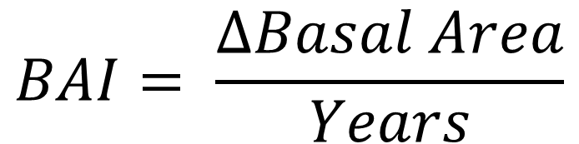
Growth effects
Annual growth- Basal area increment (BAI)
Size, Competition, and Site effects
Generalized Additive Mixed Model (GAMM) approach
$$BAI= \frac{∆Basal Area}{Years}$$
Notes:
Growth was quantified by annual basal area increment, which is the annual change of a tree’s stem area per year.
(Draw on board)
This measure was annualized because of the varying periods of time between measurements.
Since I was only interested in live-tree growth, I only used BAI values that were greater than zero
BAI cannot be negative, and thus is bound by zero.

Slide 14
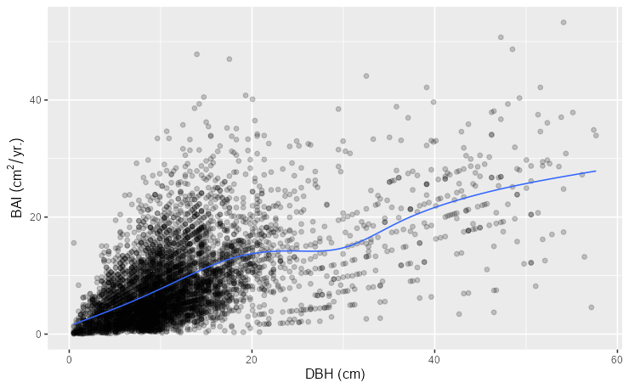
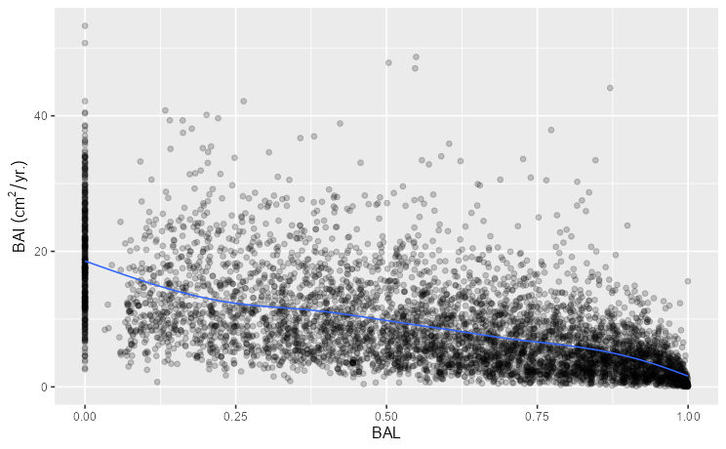
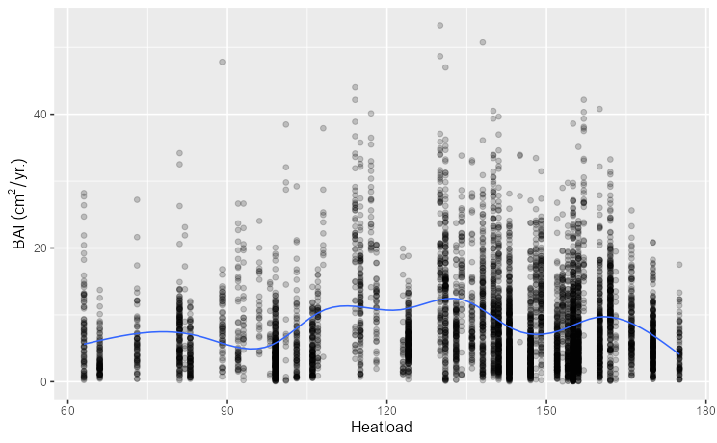
Growth effects
Annual growth- Basal area increment (BAI)
Size, Competition, and Site effects
Generalized Additive Mixed Model (GAMM) approach
$\ln\left(BAI\right)={ f}_{1}\left(Size\right)+f_{2}\left(Competition\right)+f_{3}\left(Site\right)$ + RE
Notes:
The effects of size, competition, and site on growth were captured in a model that looks something like this equation shown, where BAI depends on a combination of some function of size, competition, and site effects.
Each figure below shows BAI on the y-axis, plotted against a size variable in the left figure, a competition variable in the middle, and a site variable on the right. A smooth line was added to each plot to visualize trends in the data points.
Notice that each smooth line is not perfectly straight, and that the distribution of BAI at any given point on each x-axis is non-constant.
For example, in the figure on the left, a smaller sized tree has a limited potential range of BAI values, whereas a larger tree has wide range of BAI values.
Also, since BAI is bound by zero at the low end, we can see a clumping of data at low values.
the relationship of BAI on the y-axis with a size variable, a competition, and a site variable, on the x-axes, respectively.
We
When fitting a model, its important
In models like FVS, tree growth is estimated from variables that describe tree size, competition, and site productivity.
Models like this use nonlinear relationships to characterize growth from these variables.
Additionally, BAI is oftentimes log-transformed and is not equally dispersed throughout its range.
The figure at the bottom relates BAI (on the y) to DBH (on the x; a size variable). As you can see, there’s a near linear trend, but as DBH increases, BAI becomes more variable.

Slide 15
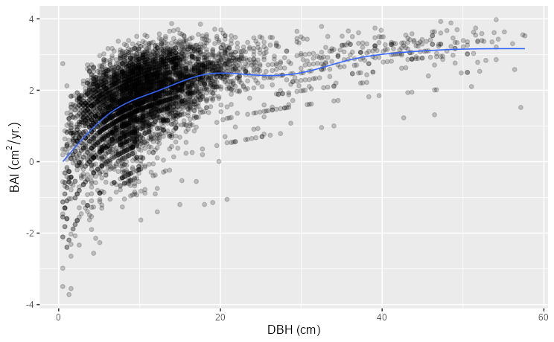
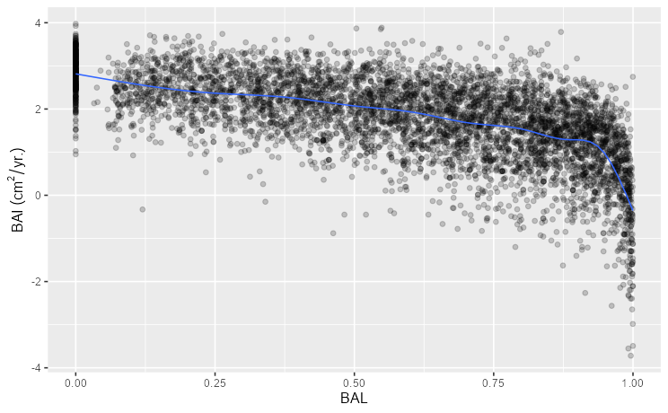
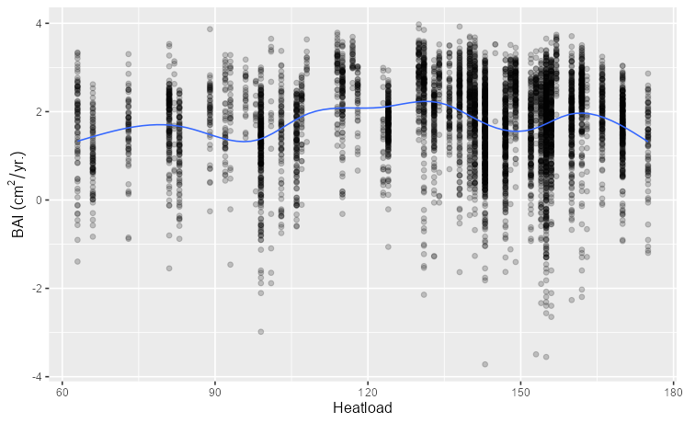
Growth effects
Annual growth- Basal area increment (BAI)
Size, Competition, and Site effects
Generalized Additive Mixed Model (GAMM) approach
$\ln\left(BAI\right)={ f}_{1}\left(Size\right)+f_{2}\left(Competition\right)+f_{3}\left(Site\right)$ + RE
Notes:
To accommodate these types of characteristics, BAI is typically modelled with a natural log transformation, as shown in the updated equation.
Each of the figures are now shown with the natural log of BAI on the y-axis. As you can see, the points are less clumped at lower values of BAI, but now the smoothed trendlines show more complex relationships that are non-linear. Additionally, at any given point of x, the distribution of BAI is still non-constant.
I used generalized additive models (or GAMs) to estimate this relationship because they allow the data determine non-linear relationships, and I used a gamma distribution family with a log-link function to accommodate the variability in BAI in response to these variables and because BAI is bound by zero.
In models like FVS, tree growth is estimated from variables that describe tree size, competition, and site productivity.
Models like this use nonlinear relationships to characterize growth from these variables.
Additionally, BAI is oftentimes log-transformed and is not equally dispersed throughout its range.
The figure at the bottom relates BAI (on the y) to DBH (on the x; a size variable). As you can see, there’s a near linear trend, but as DBH increases, BAI becomes more variable.

Slide 16
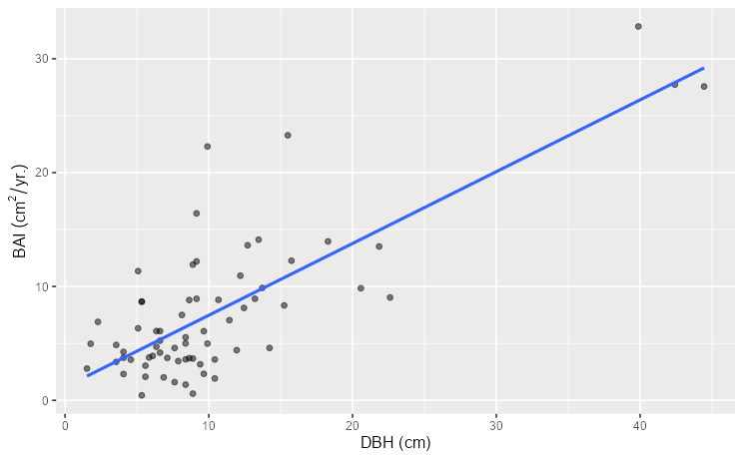
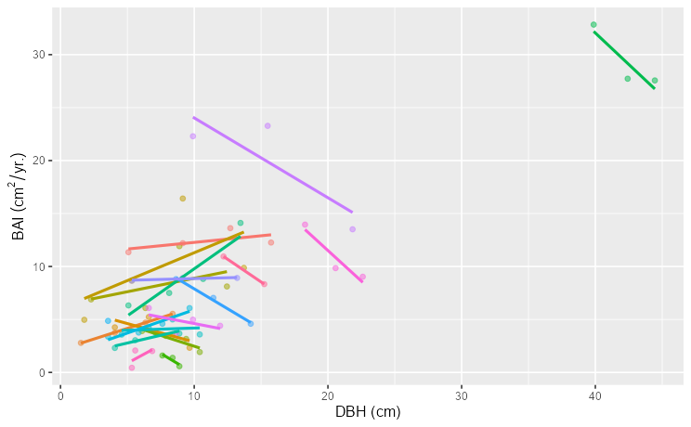
Growth effects
Annual growth- Basal area increment (BAI)
Size, Competition, and Site effects
Generalized Additive Mixed Model (GAMM) approach
$$\ln\left(BAI\right)= f_{1}\left(Size\right)+f_{2}\left(Competition\right)+f_{3}\left(Site\right)+Tree$$
Tree
Notes:
The figures below show BAI vs. DBH for a small sample of data points, fit with an overall linear trend line on the left, and trend lines for each individual tree on the right.
Since these data consist of measurements on the same trees over time, the relationship can vary for individual trees.
The figure on the right shows the same data points, but each color now represents individual trees, each fit with its own trend line.
To account for individual tree variability in growth after determining effects on growth, I added an individual tree effect to the model, as shown in the updated equation.
Since the data contain measurements on the same trees over time, each observation of BAI was not necessarily independent from other observations.
I used a mixed model to account for unknown effects on growth for each individual tree, as shown in the equation.
and variability in the relationship is bound to occur due to some unknown random effects. This warranted a mixed-model to account for unknown effects.
I accounted for these effects at the tree-level.
Ultimately a random intercept was assigned to each individual tree to account for dependence among data points.
Since nonlinear relationships were expected, and given the characteristics of BAI, a generalized additive model with a log-link and gamma distribution was used to determine a growth relationship.

Slide 17
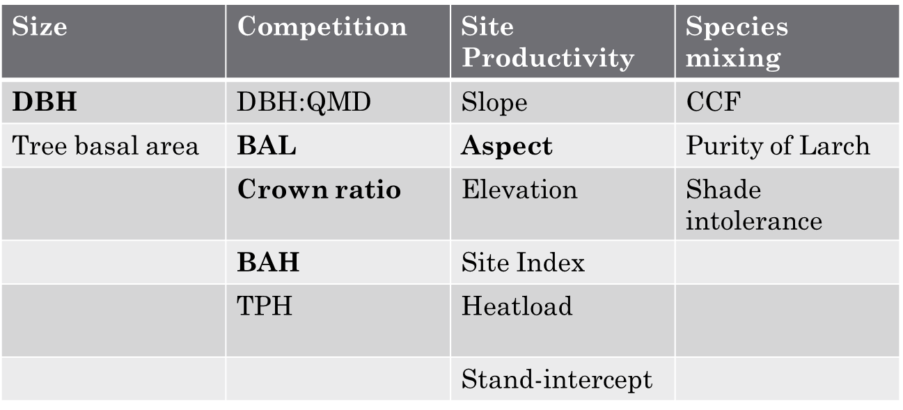
Growth effects
Variables were selected from variable groups
Size
Competition
Site
$$\ln\left(BAI\right)=f_{1}\left(DBH\right)+f_{2}\left(BAL\right)+f_{3}\left(CR\right)+f_{4}\left(BAH\right)+f_{5}\left(Aspect\right)$$
RMSE
5.64
Notes:
Since each type of effect can be represented by different variables, model predictors were selected from each group beginning with size variables.
Correlation between variables in each group was assessed, and any highly correlated variables were not considered in a model together, but rather were compared in separate models to determine which predictor was better at estimating BAI.
Models were compared based on RMSE, which is a measure of model predictive accuracy in the same units of BAI. The lower the RMSE, the higher the predictive accuracy.
Variables representing tree size were DBH and tree basal area. The model with DBH as a predictor was superior to the alternative, so DBH was used to represent size. The RMSE is shown on the right.
This order follows that of previous works (see Wykoff 1990 and Monserud and Sterba 1996)
DBH and tree basal area were compared, where DBH was selected to be included in the model.

Slide 18
Growth effects
Variables were selected from variable groups
Size
Competition
Site
$$\ln\left(BAI\right)=f_{1}\left(DBH\right)+f_{2}\left(BAL\right)+f_{3}\left(CR\right)+f_{4}\left(BAH\right)+f_{5}\left(Aspect\right)$$
RMSE
5.64
4.31
Individual tree variables
Plot-level variables
Notes:
Competition values were evaluated with DBH in the model.
The ratio of tree diameter to plot quadratic mean diameter, basal area larger than the subject tree, crown ratio, plot basal area per hectare (BAH), and plot trees per hectare were assessed.
We thought it was important to include competition variables that both described an individual tree’s competitive position compared to other trees as well as the overall competitive environment that a tree is growing within.
BAL and crown ratio were selected for the former, and BAH was selected for the latter.
RMSE is shown on the right.

Slide 19
Growth effects
Variables were selected from variable groups
Size
Competition
Site
$$\ln\left(BAI\right)=f_{1}\left(DBH\right)+f_{2}\left(BAL\right)+f_{3}\left(CR\right)+f_{4}\left(BAH\right)+f_{5}\left(Aspect\right)$$
RMSE
5.64
4.31
4.01
Evaluated together and exclusively
Evaluated exclusive of every other
Notes:
Site productivity variables considered are shown here.
Slope, aspect, and elevation were assessed together and individually before comparing to other variables. This is because each other variable represents the effects of all three of these.
Then the outcome was then compared to the rest of the group.
Ultimately aspect was selected as the site-productivity representing variable.
The best model accuracy was actually produced when slope was included in the model as well, but there was a high degree of dependence between aspect, slope, and the competition variables. This was shown by concurvity, which measures nonlinear dependence among variables in a model.
The model RMSE for the model is shown on the right in bold.

Slide 20
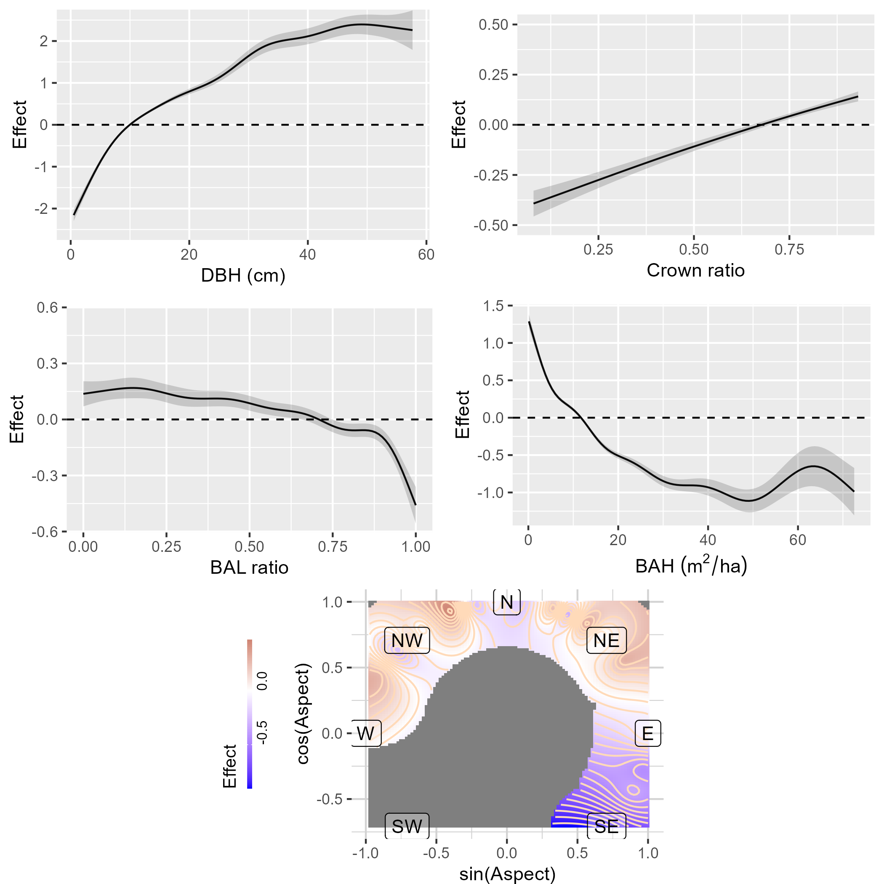
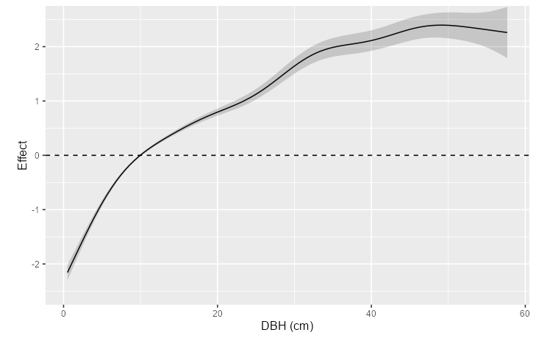
Growth effects
$$\ln\left(BAI\right)=f_{1}\left(DBH\right)+f_{2}\left(BAL\right)+f_{3}\left(CR\right)+f_{4}\left(BAH\right)+f_{5}\left(Aspect\right)$$
Notes:
The curve shown here shows the marginal effects of DBH on tree growth. The y-axis the effect on growth on the log-link scale, and the x-axis is DBH.
The log-link effect on the y-axis can simply be interpretted as a unitless multiplicative effect on BAI, but remember that BAI can only be positive.
With that said, after accounting for other variables, the effect of DBH on growth increases with DBH, showing a higher rate of increase at lower values, and then tapers at high values. This curve is very similar to the relationships identified in previous works.
On the left are the partial response of BAI (on the y-axis) to each term in the model. They are shown on the log-link scale, which is why they are centered about zero. They’re functional shapes can easily be compared to previous models on this scale since those models have used a similar scale.
DBH and crown ratio have positive associations with BAI, DBH being nonlinear, and crown ratio being near-linear on the log-scale.
BAL and BAH had negative associations with BAI, where BAL doesn’t appear relevant until values higher than 0.8.
Larch growing on northern aspects in this data set were associated with higher growth, and southern was negative, although, there wasn’t much south-aspect data. There was higher growth on north-northwest aspects.
Overall, DBH, crown ratio, and BAH all held functional relationships that are similar to those identified by previous works.
BAL was different, although the way it was quantified here was different, so it’s hard to say how it compares.

Slide 21
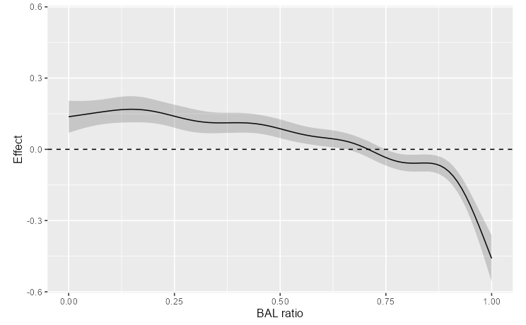
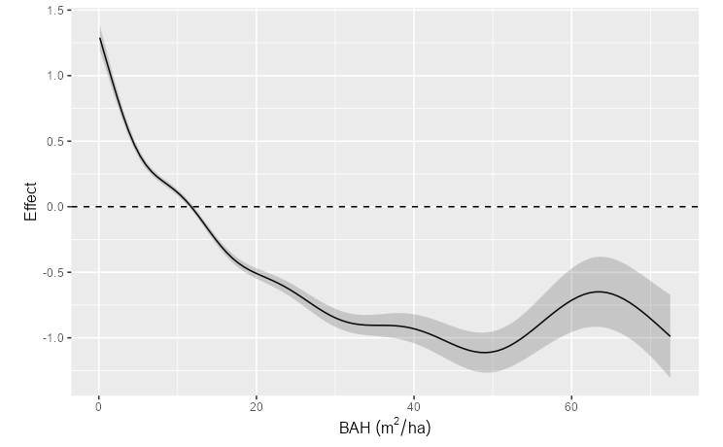
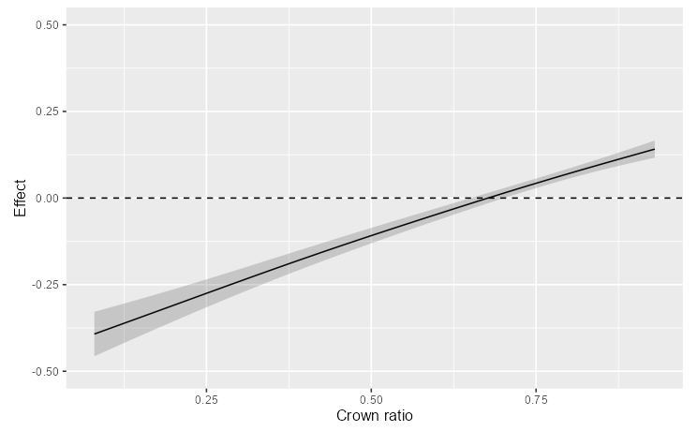
Growth effects
$$\ln\left(BAI\right)=f_{1}\left(DBH\right)+f_{2}\left(BAL\right)+f_{3}\left(CR\right)+f_{4}\left(BAH\right)+f_{5}\left(Aspect\right)$$
Notes:
Here we see the partial effects for BAL on the top left, Crown ratio on the bottom left, and BAH on the right.
BAL is a ratio of plot basal are in trees larger than the subject tree (whose growth is being estimated).
So small values represent larger trees that don’t have larger competitors, and larger values represent smaller trees which are being out-competed by larger trees.
BAL doesn’t appear to have much of an effect on growth until values are in excess of 0.8, meaning that only western larch trees that are being out-competed by a bunch of larger neighbors seem to be negatively impacted.
Crown ratio was fit as a near-linear term where higher values were associated with more growth.
BAH had an overall negative effect on growth as it increased that eventually approached a lower limit at higher densities.
These relationships are more or less similar to previously established relationships.

Slide 22
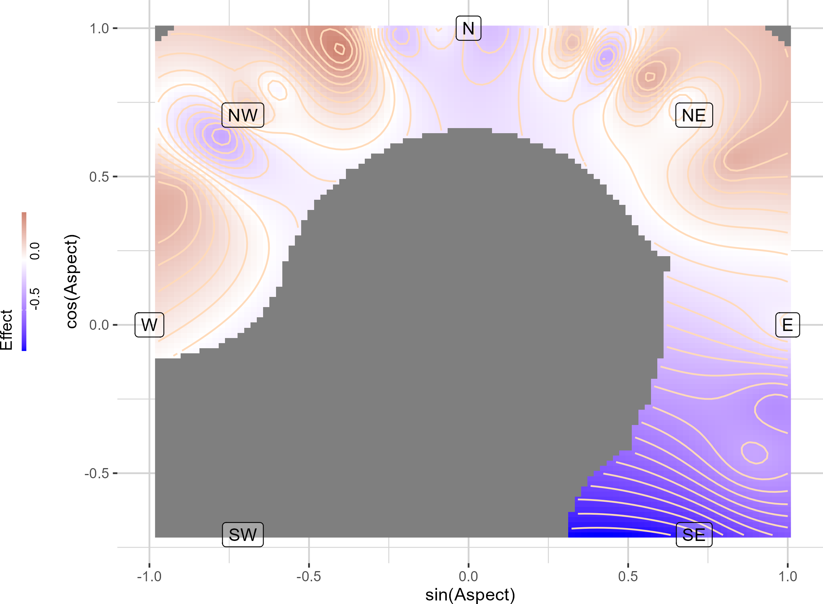
Growth effects
$$\ln\left(BAI\right)=f_{1}\left(DBH\right)+f_{2}\left(BAL\right)+f_{3}\left(CR\right)+f_{4}\left(BAH\right)+f_{5}\left(Aspect\right)$$
Notes:
Finally, here is how BAI varied with aspect.
Since aspect is a circular measure between 0 and 360 degrees, it couldn’t be related to growth in any straightforward way without applying transformations.
So, in the final model it was represented as the interaction of the sine and cosine transformations of aspect.
Here I am showing aspect in the same orientation as a compass.
The effect on BAI is shown by contours, and the color indicates positive or negative effects with red and blue, respectively.
We can see here then, that BAI varied with aspect, noting varying positive effects on northern aspects, and somewhat negative effects on NW aspects, and more negative effects on southern aspects.
Of note, however, is that there simply was not data observed on S-SW aspects, so that’s why that area is grey.

Slide 23
Objective 1 Summary
Described effects of size, competition, site
DBH, CR, BAH similar to previous
BAL ratio, not quantity
Aspect without slope and elevation
GAMMs require know-how and careful consideration
Notes:
The objective stated was to describe the effects of tree size, competition, and site productivity.
based on the improvements seen in RMSE, in addition to the similarities noted with previous works, I’d say this objective was successfully accomplished.
However, a few things of note are
BAL was a little bit different than previous works because I used a ratio instead of the totally basal area in larger trees. I did this because it otherwise shared a high correlation with plot basal area, and other variables weren’t as good as capturing the individual tree competition effect.
Using aspect as the only site effect might have some issues
It assumes that the effects of elevation and slope on growth are constant for an aspect, which isn’t necessarily true. However, Aspect simply outperformed other metrics. Perhaps a different model selection approach would yield in a different result.
In all, though, this approach yielded valid results, so let’s move forward.

Slide 24
Objectives
Describe how W. Larch growth varies with tree size, competition, density, and site productivity.
Identify if these growth effects differ between mixtures and pure larch conditions
Compare different measures of species-mixing influences on growth
Notes:
So, I showed how western larch growth varies with size, competion, density and site productivity.
Now let’s look at how these effects vary if western larch is growing in different mixtures.

Slide 25
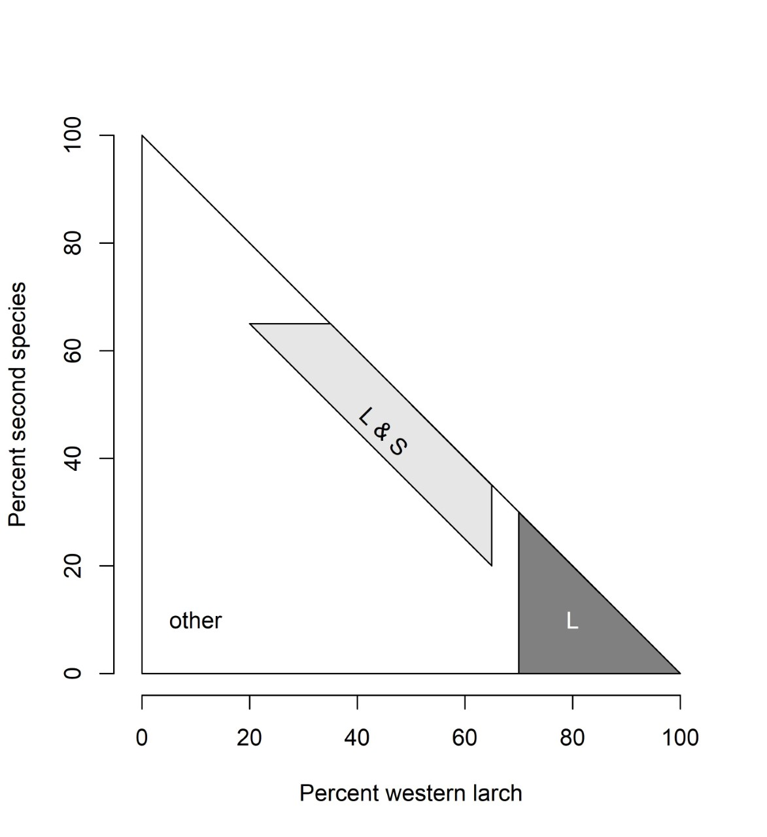
Growth effects compared between mixtures and pure conditions
Identified specific mixtures
Larch-lodgepole pine
Larch-Douglas-fir
Larch-larch
Fit model, allowing an offset for each mixture
Contrast mixtures from pure-larch conditions
Notes:
First, I needed to figure out how to define a mixture.
I did this by calculating the amount of Basal area in a plot that a species occupied and/or shared by western larch and another species.
So to qualify as a mixture, the total basal area in a plot had to be at least 20% larch, and at least 20% of another species.
On its own, neither species could occupy more than 65% of plot basal area.
And together both species had to occupy a minimum of 70% plot BA.
These parameters, while somewhat arbitrary, guaranteed that western larch was mixed with another species, and not other species.
To qualify as a pure larch plot, larch itself had to occupy at least 70% of plot basal area.
Mixtures of western larch and various other species were identified in the data set, but there was only an ample amount of data for this modeling exercise for larch mixed with lodgepole pine and larch mixed with douglas fir.
To evaluate growth effects across conditions, I fit the same model as before on the subset of data containing an identifying variable for mixtures and pure larch conditions.
This resulted in a model that allowed pure larch conditions to represent a reference level that each other mixture condition could be compared to.
In other words, a reference smooth was fitted for pure larch conditions, and a difference smooth was fit for each of the mixtures to identify whether a relationship was indeed different from the reference conditions.

Slide 26
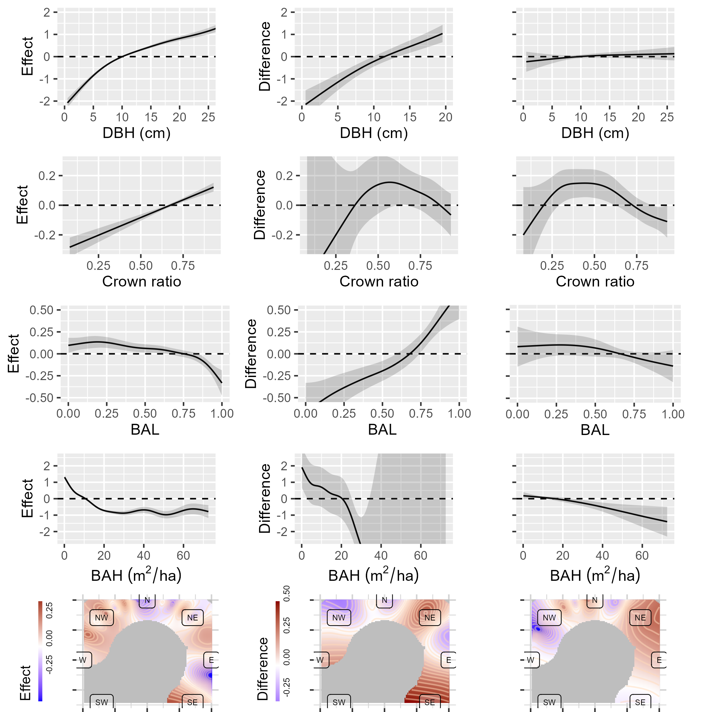
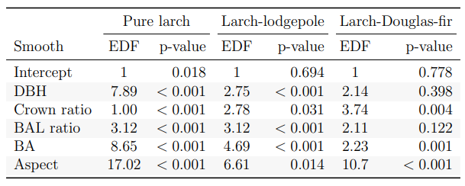
Growth effects compared between mixtures and pure conditions
Larch-lodgepole pine
Larch-Douglas-fir
Pure larch
p<0.001
p<0.001
P=0.398
p<0.001
p=0.031
p=0.004
Notes:
The resulting smooths are shown here with shaded regions representing 2 standard errors. If the shaded region crosses the 0 line, then there likely is not an effect at that point.
The p-values indicate evidence for an effect or difference.
In the column on the left are the reference smooths for the pure-larch conditions. These all had strong evidence that the fitted relationship differed from a relationship with no effect, with p-values less than 0.001.
The reference smooths are here for visual comparison, but generally speaking are quite similar to what I showed earlier.
The right two columns show difference smooths for the larch-lodgepole pine mixtures, and mixtures of larch and douglas fir.
The difference smooths show how a smooth relationship in a mixture differs from the effect shown in the reference condition across the range of the predictor.
Their associated p-values indicate evidence that the smooth relationship for a mixture is different from reference smooth, if the p-values are very low.
So these results show that DBH effects on western larch BAI are different when larch is mixed with lodgepole pine.
There is a negative difference at lower values of DBH, and a positive difference at higher values.
That is, when mixed with lodgepole pine, smaller trees would see lower growth rates, and larger trees would see higher growth rates.
There was no evidence that the smooth for douglas fir-mixed larch was different.
In the crown ratio effects on growth, there was only a difference in the larch when mixed with douglas fir, but the difference smooth shows a somewhat unremarkable difference overall.

Slide 27
Growth effects compared between mixtures and pure conditions
Pure larch
Larch-lodgepole pine
Larch-Douglas-fir
p<0.001
p<0.001
p=0.122
p<0.001
p<0.001
p=0.001
p<0.001
p=0.014
p<0.001
Notes:
For BAL, there is an interesting difference shown in the growth effect when larch is mixed with lodgepole pine.
There is a negative difference at lower values, and a positive difference at higher values.
This means that when in lodgepole pine mixtures, western larch

Slide 28
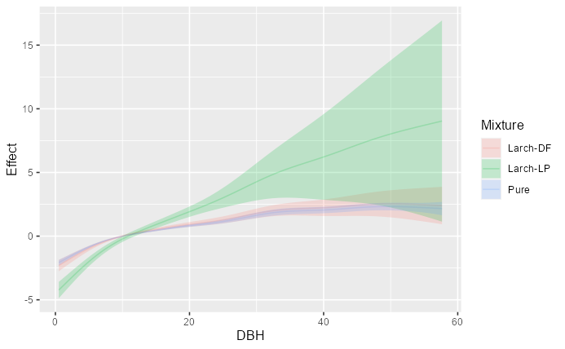
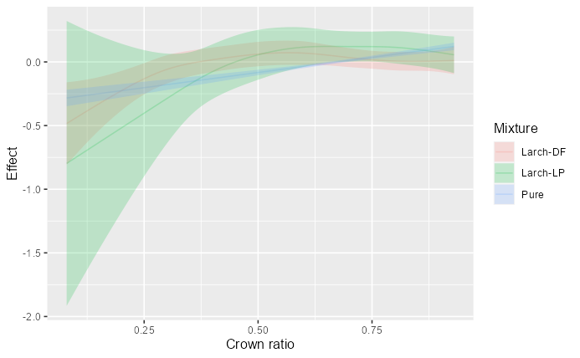
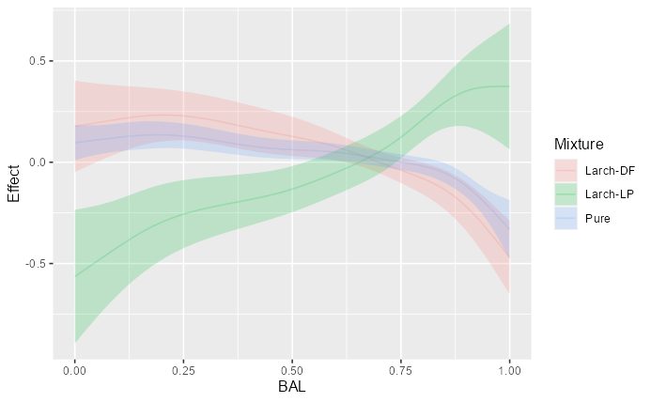
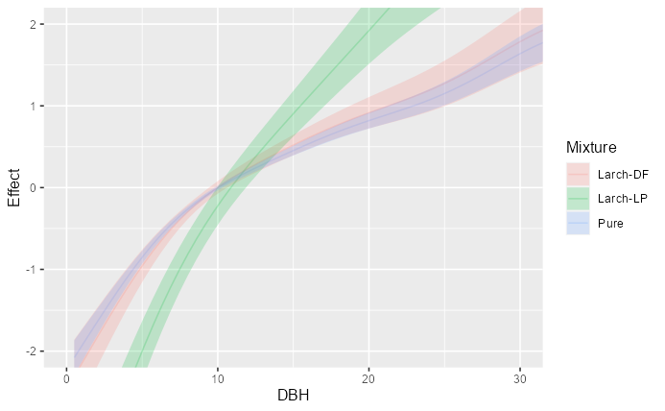
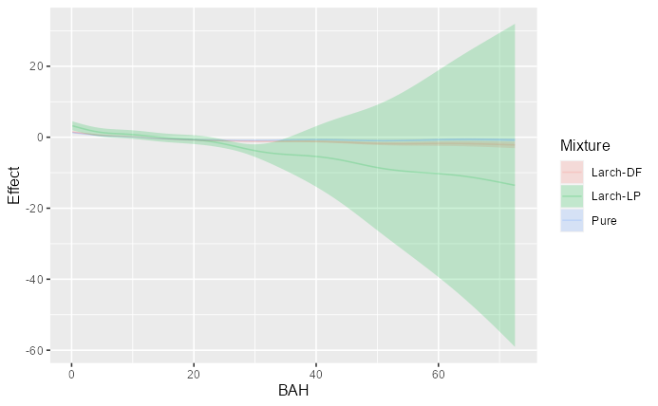
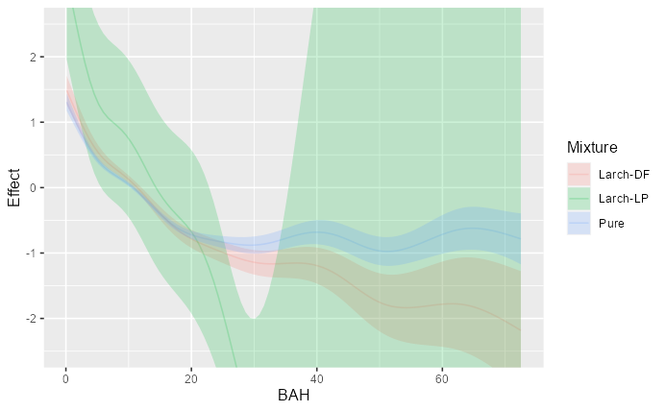

Slide 29
Growth effects compared between mixtures and pure conditions

Slide 30
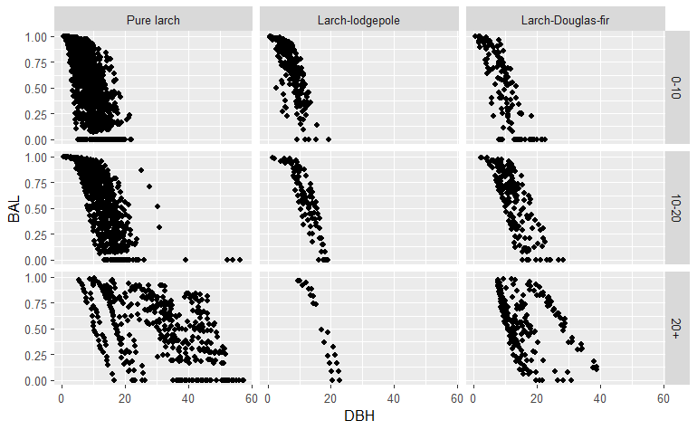
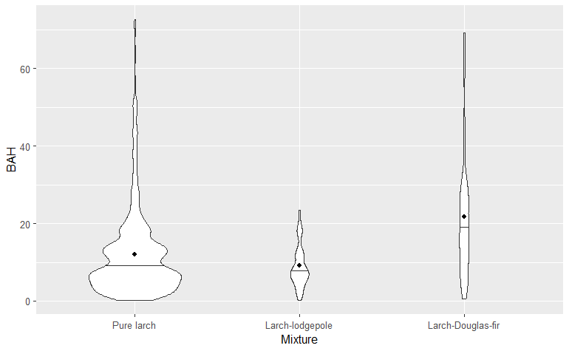
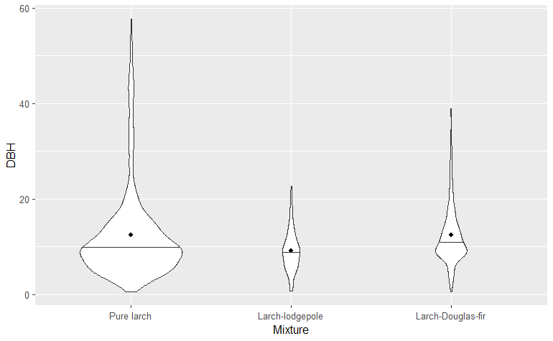
Mixtures vs. pure larch
LP differences larger than DF
Data limitations
Need more shade-tolerant species
Should assess growth of other species

Slide 31
Objectives
Identify a growth model (without species-mixing)
Identify differences in larch growth between mixtures and pure larch conditions
Compare different measures of species-mixing in the model
Notes:
With that growth model, we can now look at how larch growth varies across mixtures.

Slide 32
Comparing metrics
3 species-informed metrics
CCF – crown area based
Purity – percent of BA in larch
Shade intol. – weighted percent BA
Compare based on RMSE
$\ln\left(BAI\right)=f_{1}\left(Size\right)+f_{2}\left(Competition\right)+f_{3}\left(Site\right)+f_{4}(spp.mixing)$+ RE
$\ln\left(BAI\right)=f_{1}\left(DBH\right)+f_{2}\left(BAL\right)+f_{3}\left(CR\right)+f_{4}\left(BAH\right)+f_{5}\left(Aspect\right)+f_{6}(spp.mixing)$+ RE

Slide 33
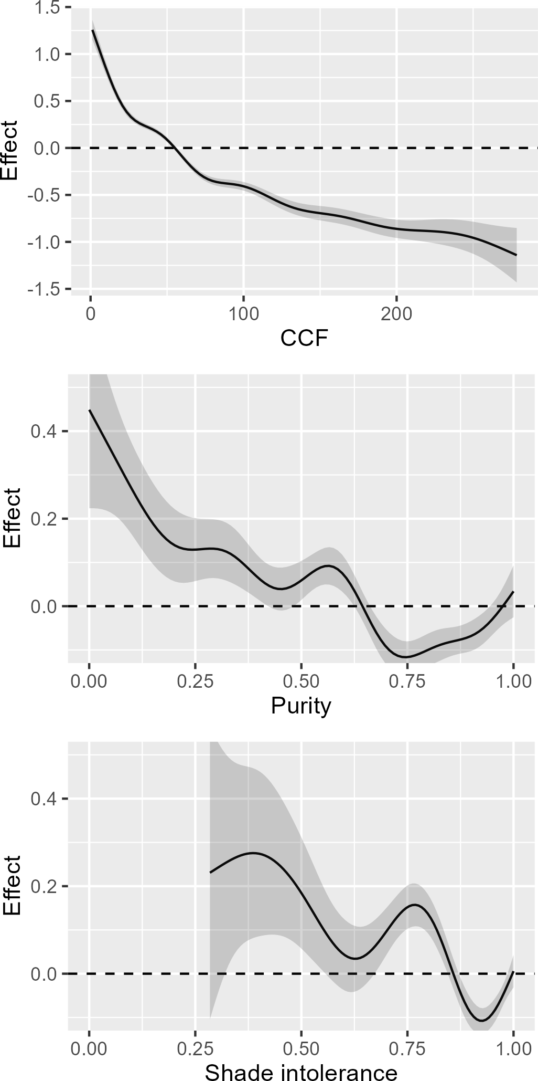
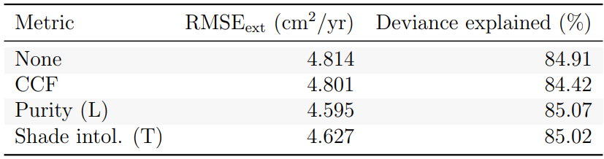
Comparing metrics

Slide 34
Comparing metrics
Modest improvements to RMSE
WL growth higher in mixtures and with shade-tolerant
Data limitations
Notes:
The figure on the right is a histogram of western larch diameter at breast height (or DBH), where observations are color-coded by tree crown class.
As you can see, tree size varied in DBH between 0 and 60 cm. and most observations were of Co-dominant trees (shown in green), and the least observations were of overtopped trees (shown by the very small purple bins), with a handful of observations of dominant and intermediate trees, shown by red and blue, respectively.
Since western larch is in
tolerant of shade and considered a pioneer species, it isn’t too surprising that it holds a relatively dominant position in communities that it grows in.
In total, the model was informed by around sixty-eight-hundred growth increments, which were recorded on about twenty-four-hundred individual larch trees.

Slide 35
Conclusions – summary
GAMMs are useful, but not perfect
WL growth different in mixtures
More growth in shade-tol.
Need more data
Analyze other spp. in mixtures
GAMMs useful
Research questions w/ answers?

Slide 36
Moving forward
Shade tolerance in growth models
More research

Slide 37
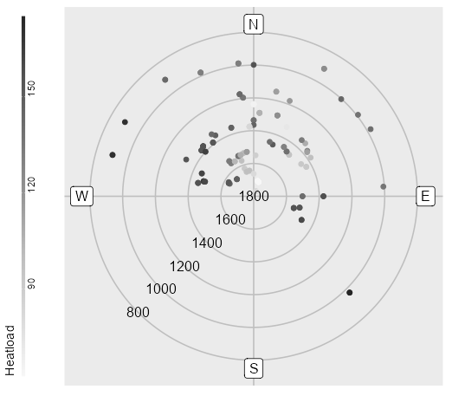

Slide 38
Objectives
Does species composition influence western larch growth?
Species composition had a minor impact on growth
How can we best characterize this effect?
Both metrics used here displayed a similar impact
Species mixture had an increasing effect on growth
Notes:
Here is a very brief summary of findings to consider as we move forward:
First, after accounting for size, competition, density, and site influences, there was a minor effect of composition on western larch growth
I used two different metrics to capture a community species composition effect – one was a relative abundance weighted by species identity; the other was a relative abundance weighted by shade-tolerance. I’ll describe these a bit more later on.
Both metrics used expressed a similar minor impact on western larch growth
As mixture decreased, the effect that it had on growth also decreased,
in other words, the growth of larch was impacted more when it was growing in more diverse communities.
With these things in mind, I’ll show you how I got to these findings.

Slide 39
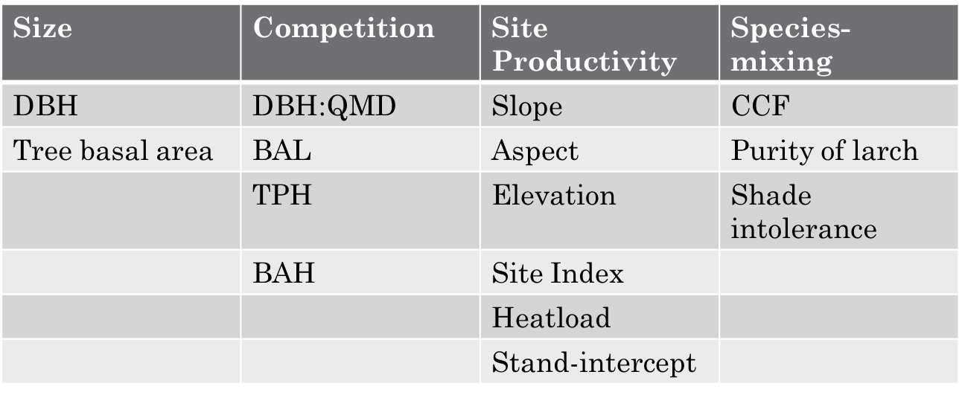
Identifying a growth model
Variables were selected from variable groups in order
$ln⁡(BAI)=f_{1}\left(Size\right)+f_{2}\left(Competition\right)+f_{3}\left(Site\right)$ + RE
Notes:
Since each type of variable can be represented by different variables, model predictors were selected from each group (size, competition, and site productivity).
Previous work has shown that size variables

Slide 40
Identifying a growth model
Variables were selected from variable groups in order
$ln⁡(BAI)=f_{1}\left(Size\right)+f_{2}\left(Competition\right)+f_{3}\left(Site\right)$ + RE
Individual tree variables
Plot-level variables
Notes:
Since each type of variable can be represented by different variables, model predictors were selected from each group (size, competition, and site productivity).
Previous work has shown that size variables

Slide 41
Identifying a growth model
Variables were selected from variable groups in order
$ln⁡(BAI)=f_{1}\left(Size\right)+f_{2}\left(Competition\right)+f_{3}\left(Site\right)$ + RE
Notes:
Since each type of variable can be represented by different variables, model predictors were selected from each group (size, competition, and site productivity).
Previous work has shown that size variables

Slide 42
Identifying a growth model
Size | Competition | Site Productivity | Species mixing
DBH | DBH:QMD | Slope | CCF
Tree basal area | BAL | Aspect | Purity of Larch
 | TPH | Elevation | Shade intolerance
 | BAH | Site Index
 |  | Heatload
 |  | Stand-intercept
Variables were selected from variable groups in order
$ln⁡(BAI)=f_{1}\left(Size\right)+f_{2}\left(Competition\right)+f_{3}\left(Site\right)$ + RE
Notes:
Since each type of variable can be represented by different variables, model predictors were selected from each group (size, competition, and site productivity).
Previous work has shown that size variables

Slide 43
Methods: BAI GAM
Modeling BAI to determine if/how species-mix alters growth
Using Generalized Additive Modeling (GAM)
Using RMSE for model selection
Construct base-model in iterations: variable group-by-variable group
Size, Site, Density & Competition (tree-variables, plot variables)
$$ln⁡(BAI)=f_{1}\left(Size\right)+f_{2}\left(Site\right)+f_{3}\left(Competition\right)+f_{4}(Species−Mixing)$$
Base model
Notes:
To test if species-mixing impacts larch growth, I’m performing a model-driven analysis using Generalized Additive Models (or GAMs), where I use the PGP data to estimate basal area increment of larch and evaluate the effects of different predictors.
I’m using GAMs because they allow for flexibility in the model fitting process by representing non-linear relationships with smooth functions, allow the data to determine the shape of the functional relationship, and they lack the assumption/structure that traditional linear modeling approaches require.
This approach is more or less inspired by a combination of the works of Vospernik 2020, Wykoff 1990, and Monserud & Sterba 1996
Since the PGP data contain lots of variables that have already been used to estimate BAI, such as in the diameter increment model applied by FVS, it’s important that I make use of variables that we already know account for variability in BAI.
To do that, I’m setting up a base-model with such variables, so that I can have a foundation upon which I can apply a variable that represents a species-mixing effect
I’m doing this in an iterative manner, where I’ve grouped variables together by similarity, and then use RMSE and other metrics to compare models with one another
For example, variables that account for tree size are grouped, variables describing site conditions are grouped together, and variables describing competition and density are grouped together
Anyways, If you didn’t follow that, don’t worry - I’ll give more details of this model selection process in the following slides
Nope
I’m using RMSE because 1. it measures model accuracy in the same units described – so everything I compare will be compared in square inches or square cm’s per year (which is what BAI is measured in). And 2. because it can be used to penalize a model by accounting for it’s complexity, which is important since I’m dealing with more than a few predictor variables. Further, I can also use RMSE as a measure of model accuracy when I validate my model with an indepent-withheld data set, and be able to compare the error there, relative to the RMSE I saw during the fitting process.

